Slide 1
Text Summarization Using Transformer Models
In an age of information overload, text summarization emerges as a critical tool. This project explores the power of Transformer-based models, specifically T5 and PEGASUS, to condense vast amounts of text into concise, meaningful summaries.
Name : AHMED HASSAN
Date 12 November 2025 Data Science Buildables

Slide 2

The Challenge: Information Overload
The digital era brings an unprecedented volume of information—news, research, reports—making it impossible for individuals to consume everything. This constant influx leads to:
Time constraints for comprehensive reading
Difficulty in extracting core insights rapidly
Increased cognitive load from excessive content
Our motivation was to combat this by developing an automated summarization system.

Slide 3

Project Goals & Exploration
Our primary objective was to build a system that could:
Understand Key Meaning
Generate Readable Summaries
Save Time & Effort
Accurately grasp the core message of any given article.
Enable users to quickly absorb long-form content, significantly reducing reading time.
Produce concise, fluent, and coherent summaries automatically.
This project also served as an opportunity to delve deep into Natural Language Processing (NLP) and the intricacies of Transformer architectures, which are foundational to modern AI language systems.

Slide 4
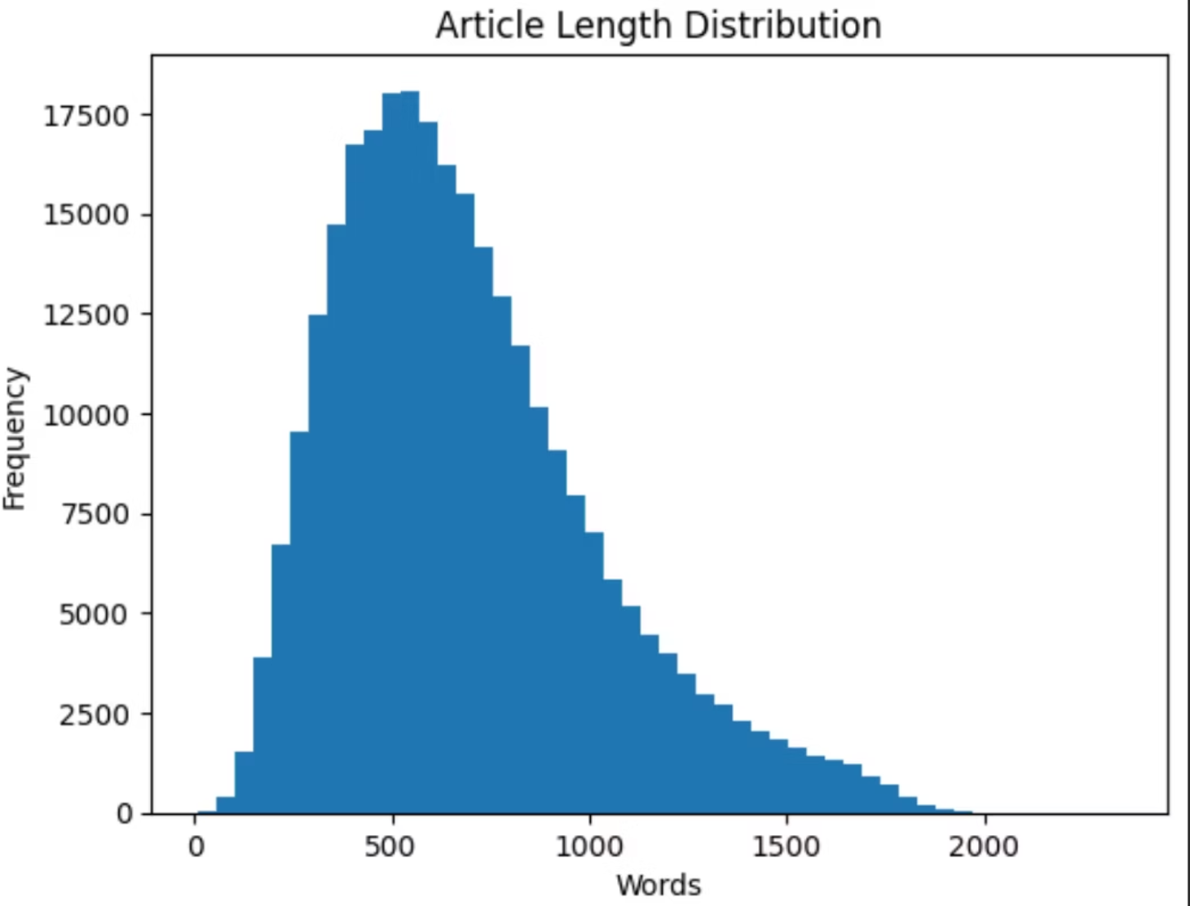
Dataset: CNN/DailyMail — The Benchmark
We utilized the widely recognized CNN/DailyMail dataset, a standard benchmark for text summarization. It comprises thousands of news articles from CNN and Daily Mail, each meticulously paired with a human-written summary, known as "highlights."
Article: The complete news story text.
Highlights: The corresponding human-crafted summary.
To optimize training, smaller subsets were selected: 5,000 samples for training and 500 for validation. Prior to model training, crucial data cleaning and Exploratory Data Analysis (EDA) were performed, including checks for null values, duplicates, and article length analysis.

Slide 5
T5-small vs PEGASUS
T5 (Text-to-Text Transfer Transformer) is a groundbreaking model that unifies all NLP tasks into a single text-to-text format. For summarization, this means:
PEGASUS, developed by Google, is specifically engineered for abstractive text summarization. Its strength lies in understanding sentence-level relationships to produce summaries that closely mimic human writing, often generating novel phrases not present in the original text.
"summarize: [article text]"
The model then learns to generate the summary directly as its output. We fine-tuned T5-small due to its efficiency and suitability for resource-constrained environments like Google Colab GPUs. Our training settings were:
During our evaluation, PEGASUS consistently outperformed T5 in terms of ROUGE scores, indicating higher quality summaries. However, its significant model size (~2.1 GB) presented deployment challenges, particularly for GitHub hosting and easy integration. This trade-off between performance and practicality led us to a strategic decision for deployment.
Epochs: 2
Batch size: 8
Learning rate: 5e-5
Optimizer: AdamW

Slide 6
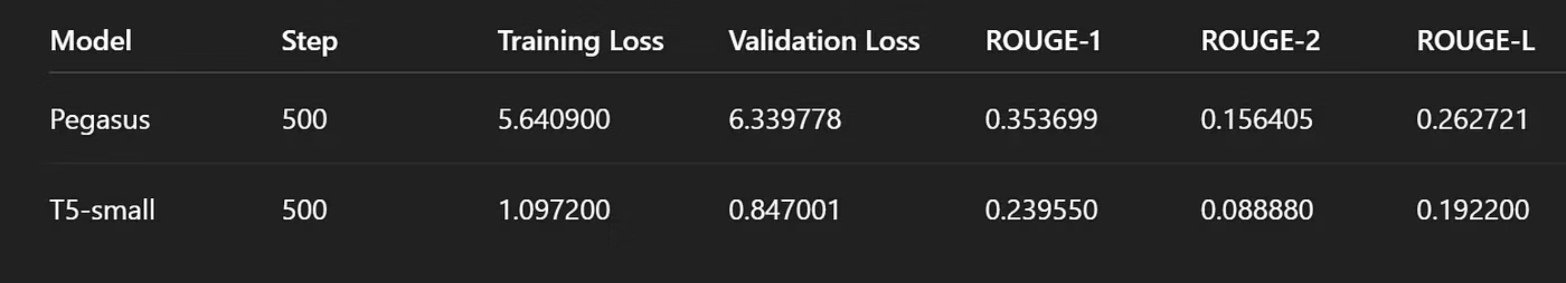
Evaluation: ROUGE Metrics
To objectively assess model performance, we employed ROUGE (Recall-Oriented Understudy for Gisting Evaluation) metrics, which measure the overlap between generated summaries and human-written reference summaries.
ROUGE-1
ROUGE-2
ROUGE-L
Measures the overlap of unigrams (single words).
Measures the overlap of bigrams (pairs of words).
Measures the longest common subsequence, capturing sentence-level structure.
While PEGASUS yielded superior ROUGE scores, T5-small struck an optimal balance between summarization quality, inference speed, and model footprint, making its generated summaries clear, concise, and effective in capturing main ideas.

Slide 7
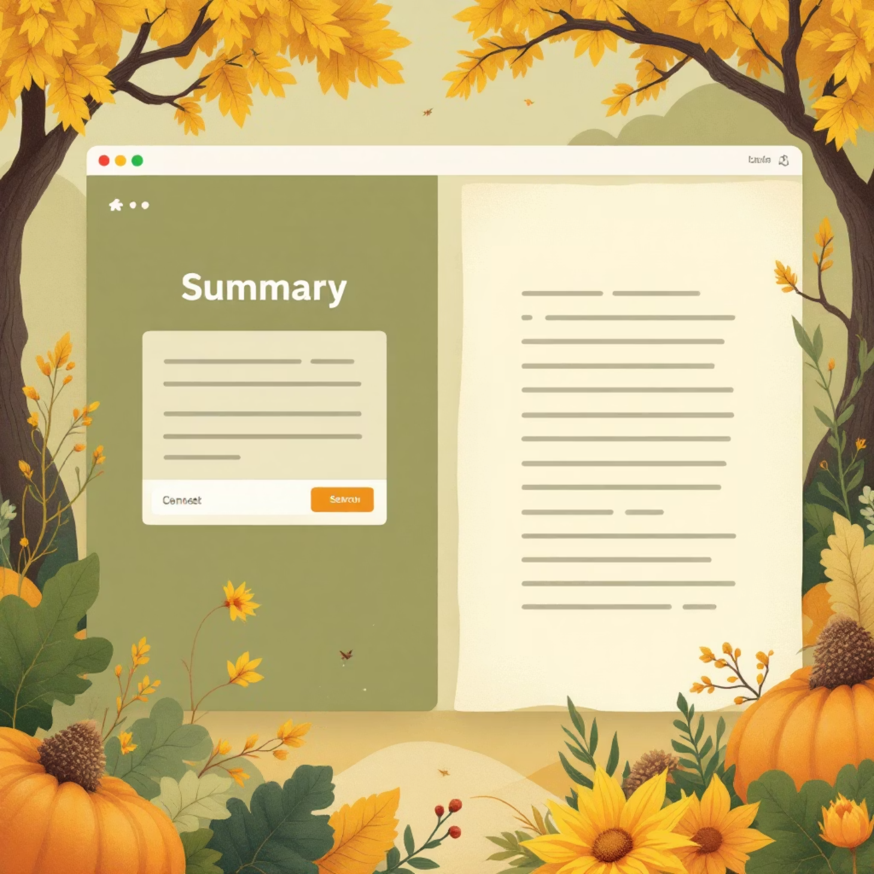
Deployment: Bringing T5-small to Life
Given the practical considerations of model size and performance balance, the T5-small model was chosen for deployment. We leveraged Flask, a lightweight Python web framework, to create a user-friendly interface.
Users can input any paragraph.
The model instantly generates a concise summary.
This deployment makes the power of Transformer-based summarization accessible, demonstrating its real-world utility.
GitHub Repository
Live Demo

Slide 8





Key Learnings & Future Outlook
Data Preprocessing
Mastered techniques for cleaning and preparing text data for NLP tasks.
Transformer Architectures
Gained deep insights into the mechanics of T5 and PEGASUS models.
Model Evaluation
Understood the critical role and application of metrics like ROUGE.
Deployment Strategy
Learned fine-tuning and deployment of large NLP models, including crucial trade-offs.
Size vs. Performance
Recognized the balance between model size and performance in practical applications.

Slide 9

Conclusion: The Power of Automated Summarization
This project successfully demonstrated the transformative power of AI in automating text summarization using state-of-the-art Transformer models. While PEGASUS showcased superior accuracy, T5-small proved to be the more practical choice for deployment due to its efficiency and smaller footprint.
Future Work:
Expansion to multi-language summarization.
Development of topic-based summaries for specialized content.
Exploration of more advanced hardware for larger models.
Text summarization is an evolving field within NLP, promising even more sophisticated and impactful applications in managing and understanding vast information landscapes.

